Slide 1


Titolo presentazione sottotitolo
Extended project work
Milano, XX mese 20XX
A Gazebo car simulator, analysis and comparison with a single-track model

Slide 2
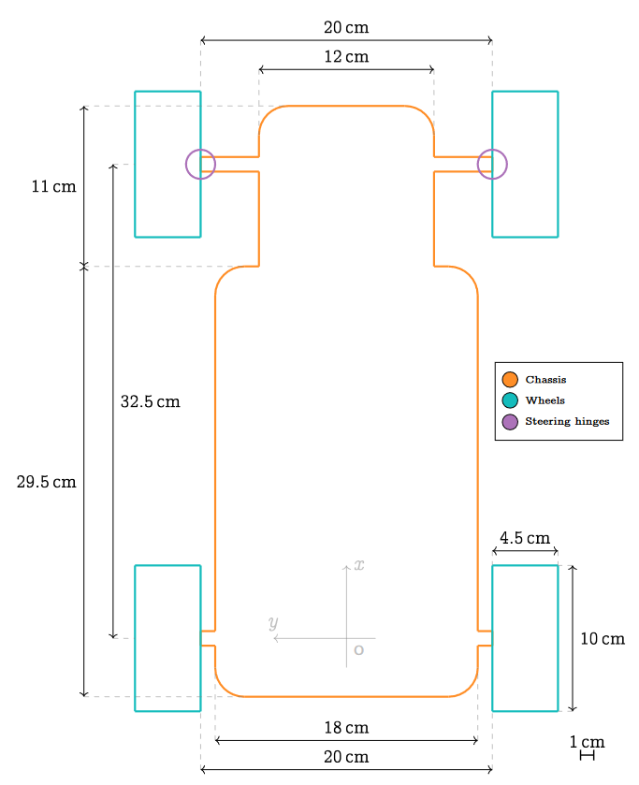
MIT racecar Model schematic

Slide 3
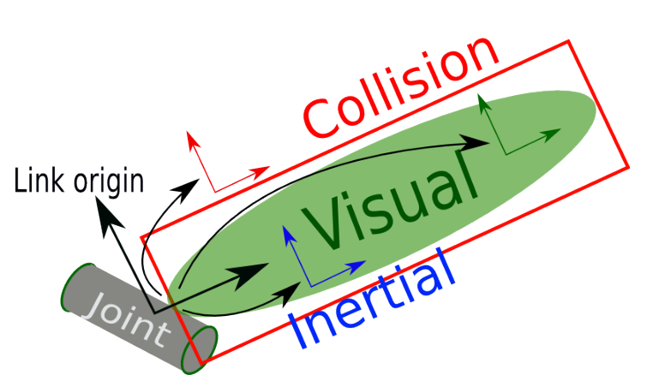
URDF standard Links
Used to describe a rigid body, can be configured specifying:
Inertial parameters: mass, inertial matrix, COG position
Visual parameters: how it is rendered in the simulation
Collision parameters: how to perform collision detection with other bodies

Slide 4
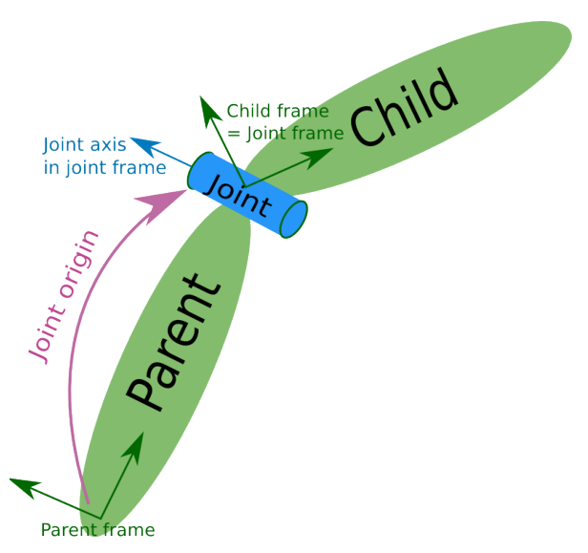
URDF standard Joints
Used to describe connections between rigid bodies and the motions allowed, can be
configured specifying:
Link type (n of free DOFs): revolute, continuous, prismatic, fixed, …
Parent and child links to be joined

Slide 5
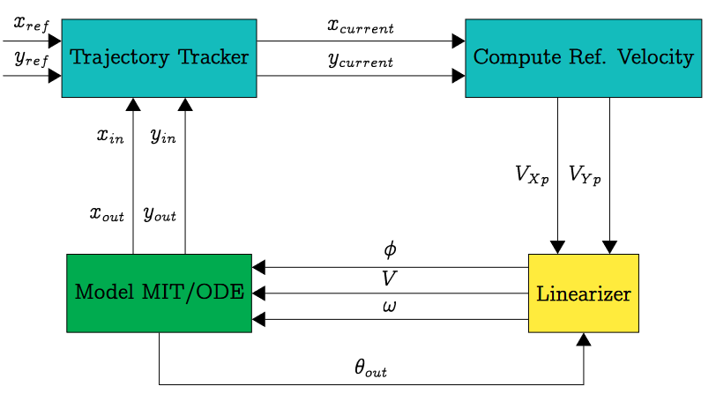
Our System Description

Slide 6
Topics
[SUB] /virtual_velocities →Used to retrieve desired velocities of the reference points computed by trajectory tracker.
[SUB] /vesc/odom →Used to retrieve the rotation of the car on the z-axis.
[PUB] /vesc/ackermann_cmd_mux/input/navigation/ → Used to publish V and φ (steering angle), which are the results of linearization. These values are read by Gazebo to make the car move. They are put into an AckermannDriveStamped message.

Slide 7
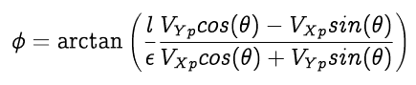
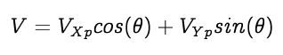
Change of coordinates applied

Slide 8
Parameters
L → Distance between front and real axle.
ε → Distance between center of gravity and a point P, along velocity vector. Linearization is done around point P.

Slide 9
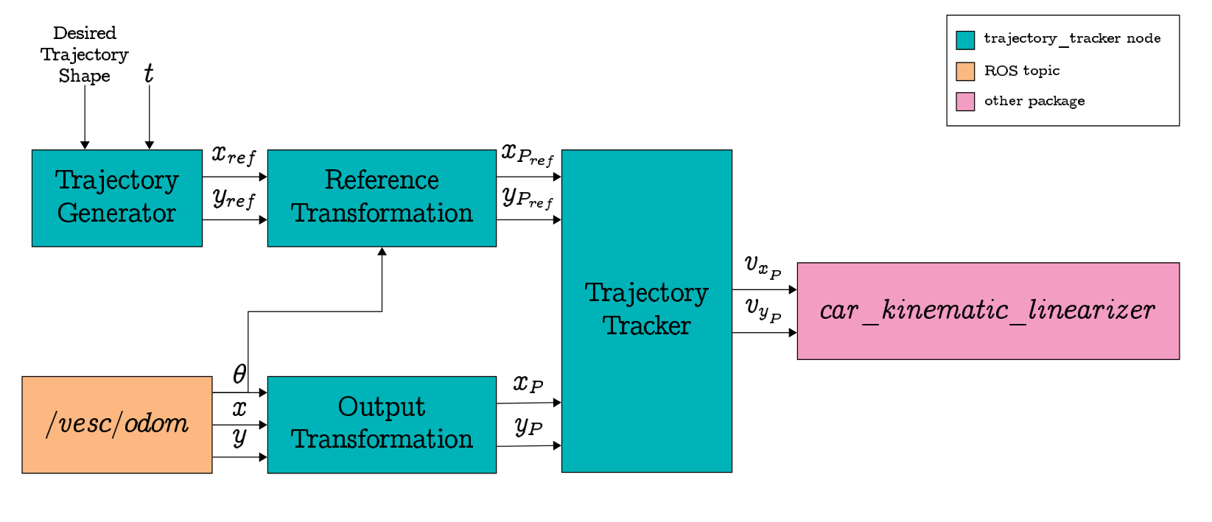
Trajectory Tracker Overview

Slide 10
Trajectory Tracker Trajectory generator
Computes the next trajectory setpoint given the desired trajectory shape and the time t elapsed since the starting of the motion.
From trajectory_tracker.yaml we can select the desired trajectory shape and the parameters relative to the specific shapes (e.g., speed, direction, sizes, …)

Slide 11
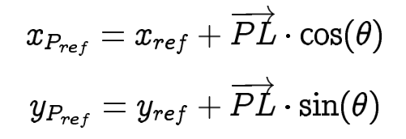
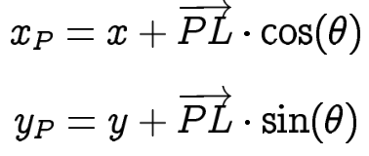
Trajectory Tracker Reference and output transformations
Since we linearized around fictitious point P (which does not coincide with the car COG), we need two changes of coordinates
before applying the control law.
to adapt the generated trajectory from the COG to P
(P will track the translated trajectory so that the COG
follows the desired path)
to get the coordinates of point P (x_{P} , y_{P} )
given those of the COG (x,y)
Where PL is the distance between point P and the car COG

Slide 12
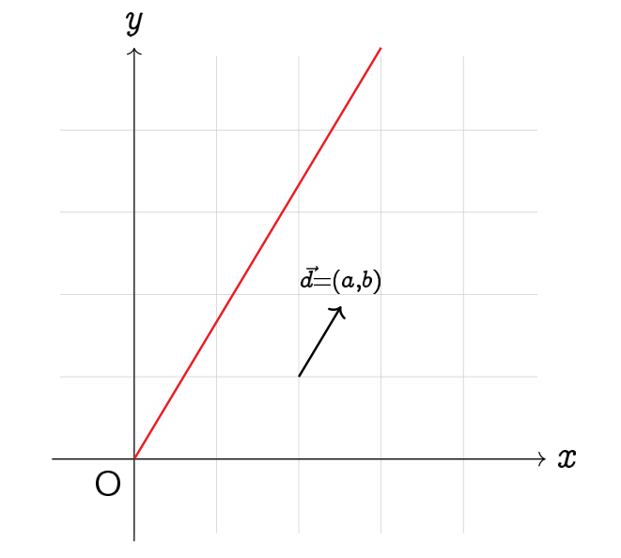
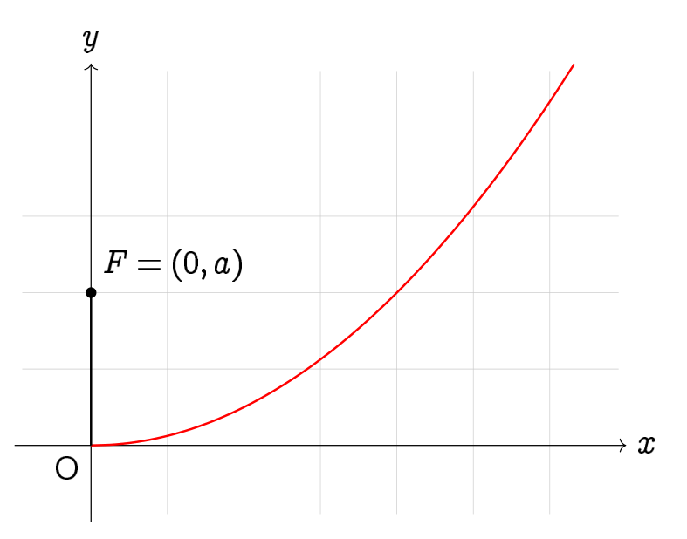
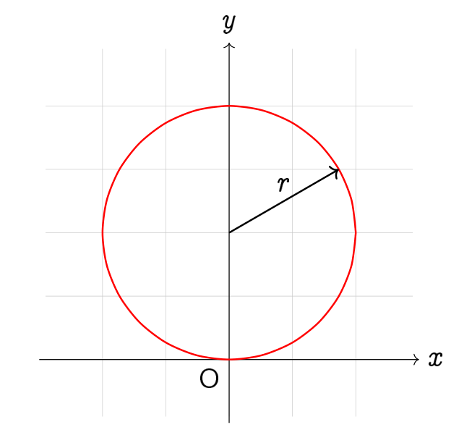
Trajectory Tracker Trajectory generator
The shapes already implemented are:
Linear
Parabolic
Circular

Slide 13
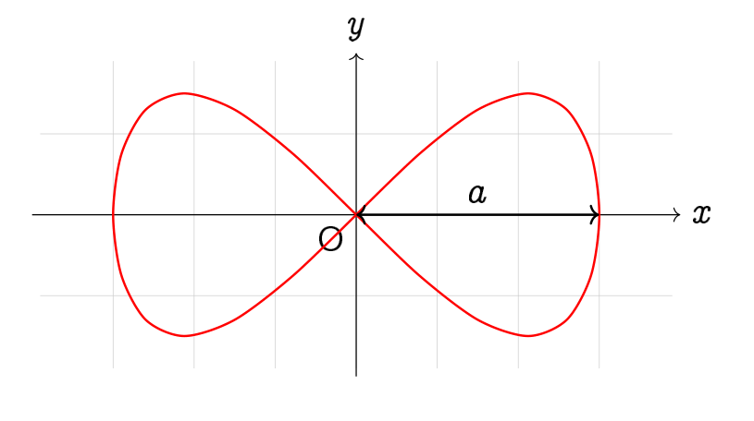
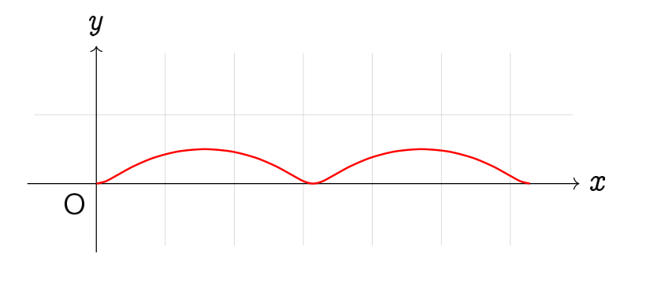
Trajectory Tracker Trajectory generator
8-shaped
Curtate Cycloid
Parabolic

Slide 14
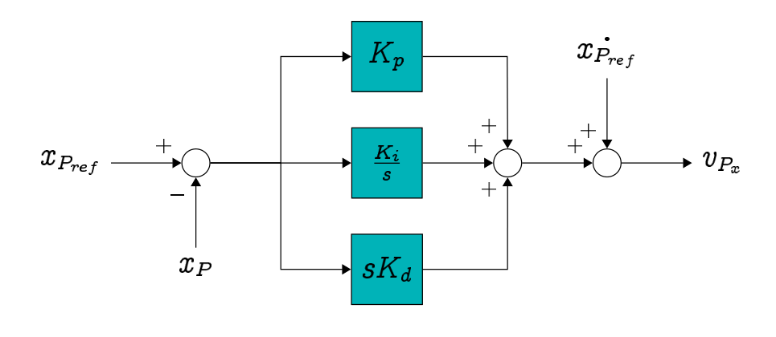
Trajectory Tracker Controller
Implemented two identical PID controllers with feedforward, one for
each controlled dimention
However, a simple P controller with velocity feedforward is enough
to obtain good results.

Slide 15
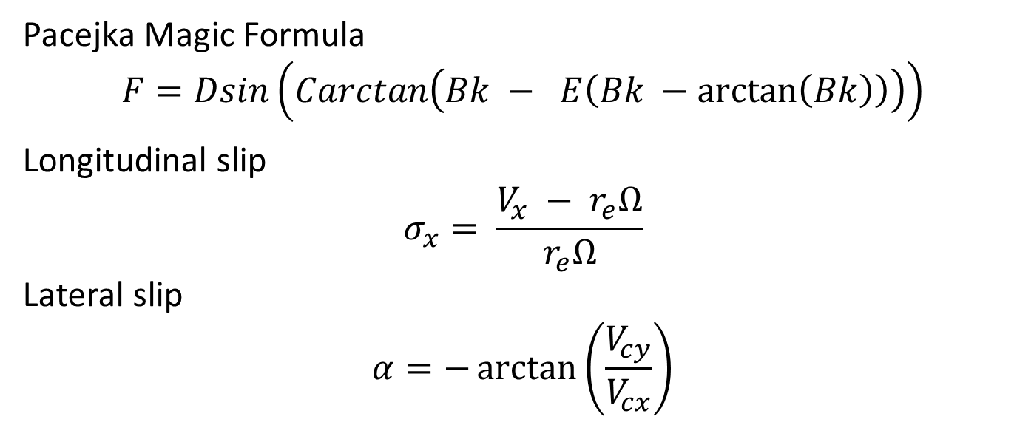
Plugin: gazebo_ros_pacejka
Pacejka Magic Formula
$$F=Dsin\left(Carctan\left(Bk − E\left(Bk −\arctan\left(Bk\right)\right)\right)\right)$$
Longitudinal slip
$$σ_{x}= \frac{V_{x} − r_{e}Ω}{r_{e}Ω}$$
Lateral slip
$$α=−\arctan\left(\frac{V_{cy}}{V_{cx}}\right)$$

Slide 16
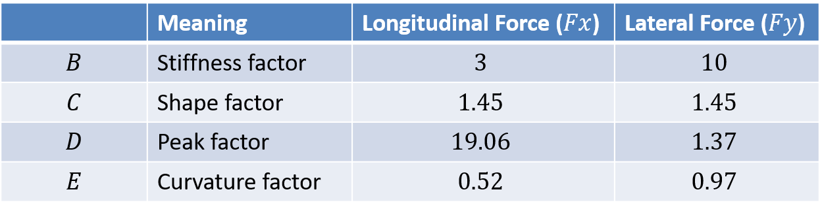
Plugin: gazebo_ros_pacejka
Parameter values of the Pacejka Magic Formula

Slide 17
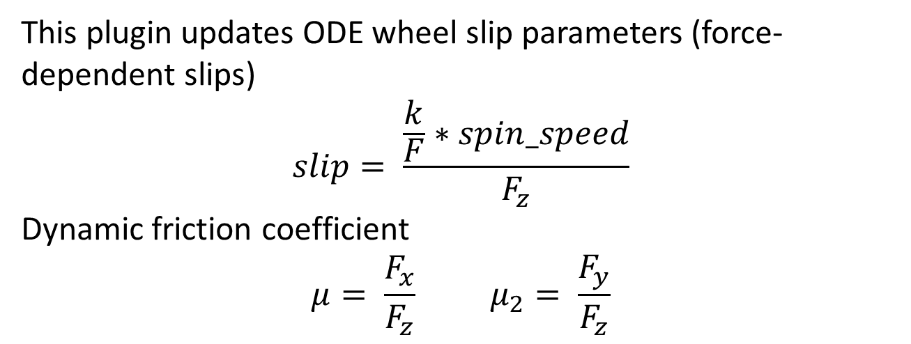
Plugin: gazebo_ros_pacejka wheel_slip_pacejka
This plugin updates ODE wheel slip parameters (force-dependent slips)
$$slip= \frac{\frac{k}{F}∗spin_speed}{F_{z}}$$
Dynamic friction coefficient
$$μ= \frac{F_{x}}{F_{z}} μ_{2}= \frac{F_{y}}{F_{z}}$$

Slide 18
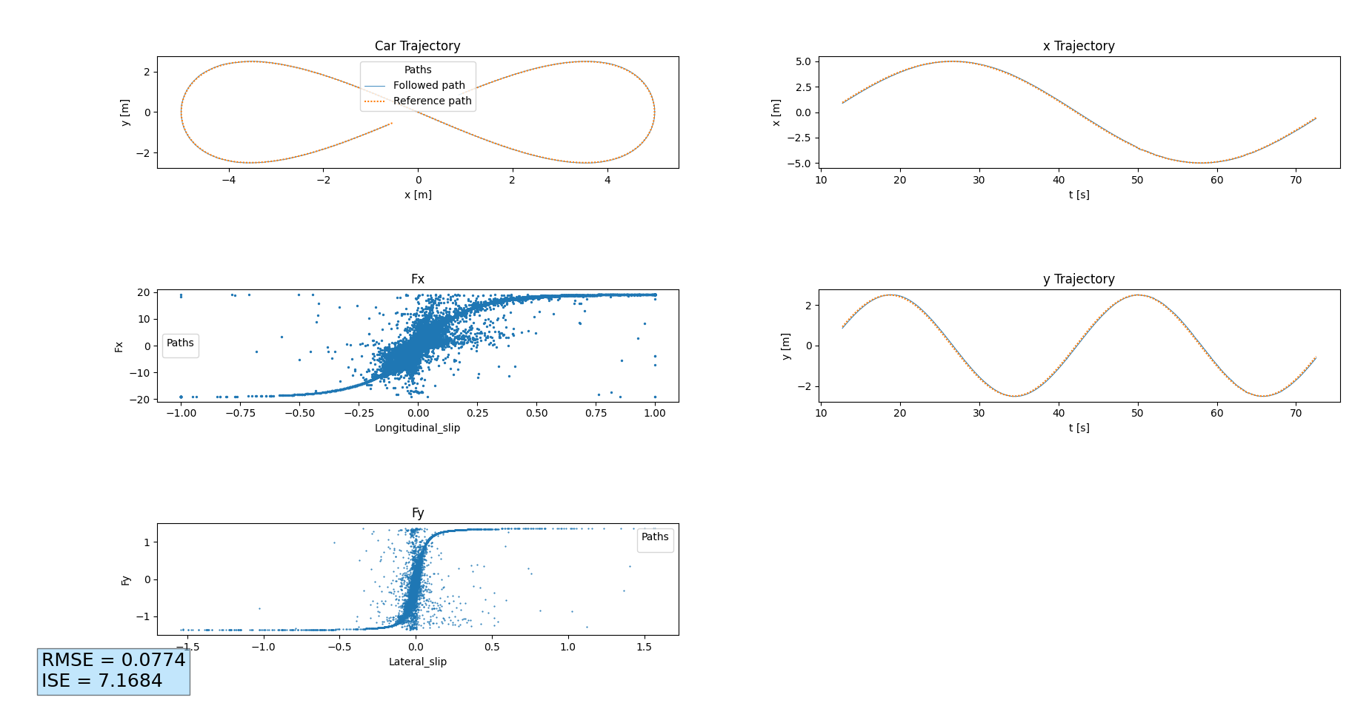
Plugin: gazebo_ros_pacejka Tests
Eight-shape trajectory

Slide 19
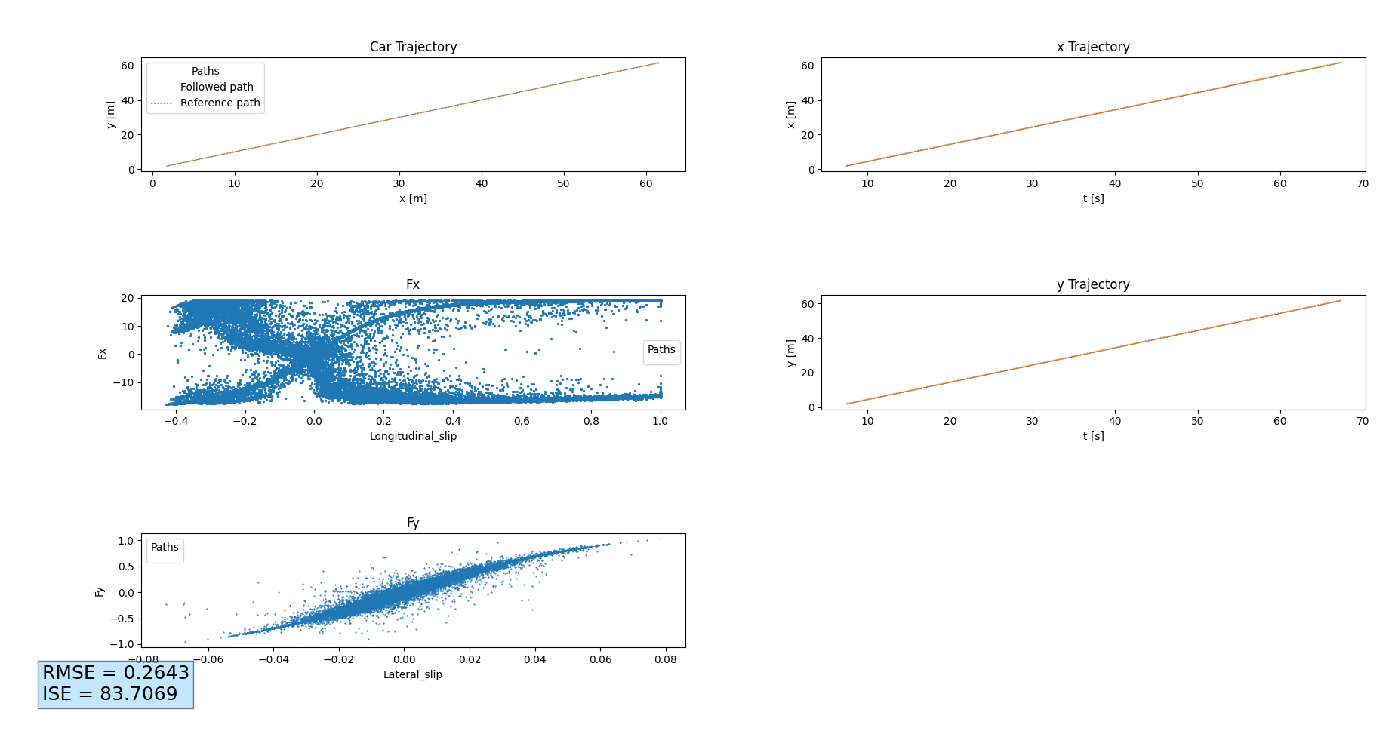
Plugin: gazebo_ros_pacejka Tests
Linear trajectory

Slide 20
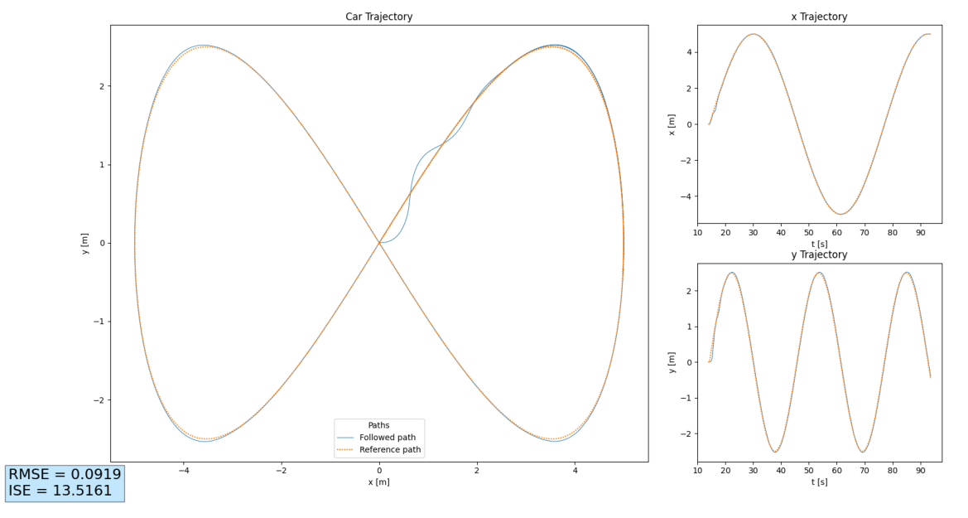
Tests Gazebo simulator

Slide 21
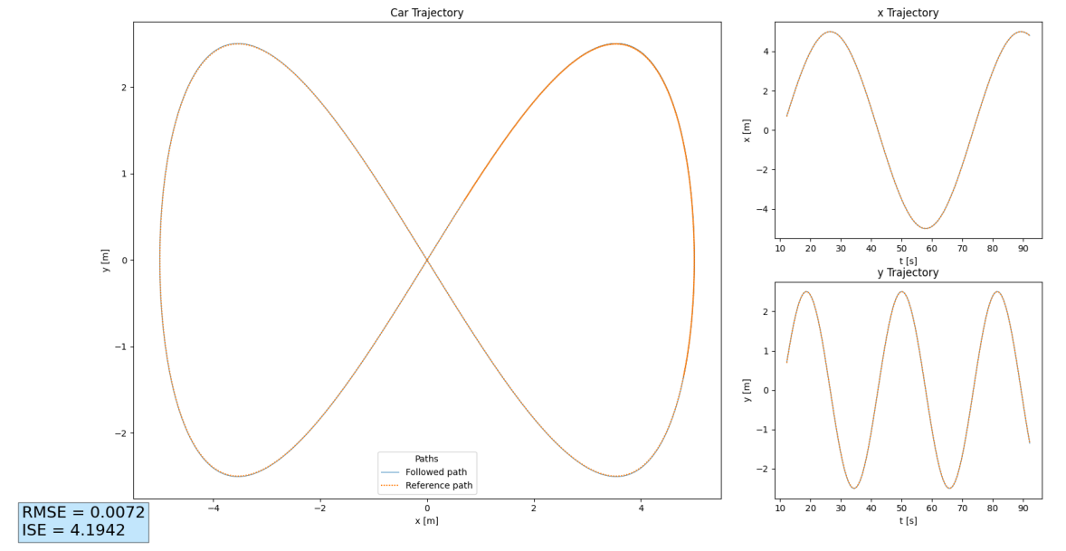
Tests ODE single track

Slide 22

Firma convenzione Politecnico di Milano e Veneranda Fabbrica del Duomo di Milano
Aula Magna – Rettorato
Mercoledì 27 maggio 2015

